Slide 1

Learning to swim
2019
Artificial Edition
6-8 February
An introduction to Azure Data Lake
Alexander Arvidsson
@arcticdba

Slide 2


Slide 3
Find out what a DATA LAKE is
Look at USE CASES for a data lake
Avoid classic data lake MISTAKES

Slide 4
A better way of storing
DATA

Slide 5





Principal Solutions Architect @ Atea
| Data Platform MVP | Speaker | Blogger |
| Podcaster | Pluralsight author |

Slide 6
Putting Azure Data Lake into CONTEXT

Slide 7

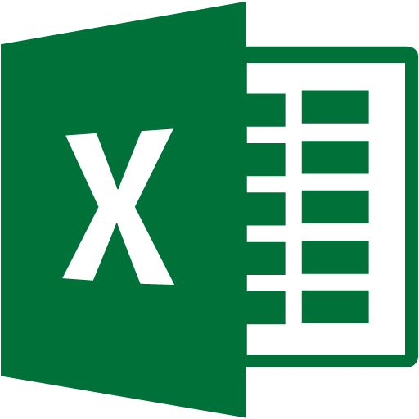

Slide 8




Slide 9


Slide 10




Slide 11


Processing
Insights
Cognitive services
Data sources
Storage

Slide 12
What IS an Azure Data Lake?

Slide 13
A REPOSITORY for storing
vast amounts of data from DISPARATE sources in its
NATIVE format
(forever)

Slide 14
STRUCTURED DATA
fixed fields, fixed schema
SEMI-STRUCTURED DATA
self-describing, no formal structure
UNSTRUCTURED DATA
no structure, no organization

Slide 15
What is an Azure Data Lake –
in a TECHNICAL sense?

Slide 16

AZURE STORAGE
Object store
Data replication options
Available everywhere
Archive tiers
Key/value pairs (metadata)
ADLS (Gen1)
Hiearchical file system
Big data optimizations
Parallelized reads and writes
Scale out
Fine-grained security
ADLS (Gen2)
Multi-modal storage
Combining the best of both worlds

Slide 17
Data Processing
Data sources

Slide 18
The schema is defined at READ instead of at WRITE

Slide 19
Raw

Slide 20
Raw
Staging
Dev
Prod

Slide 21
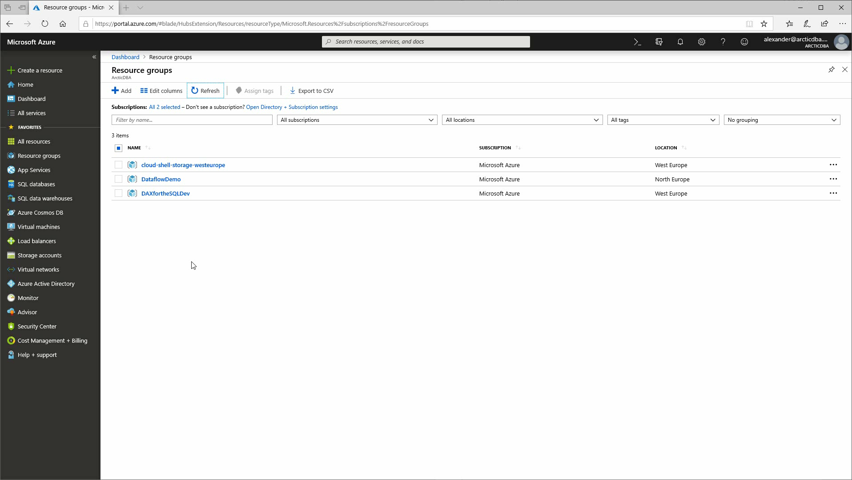

Slide 22
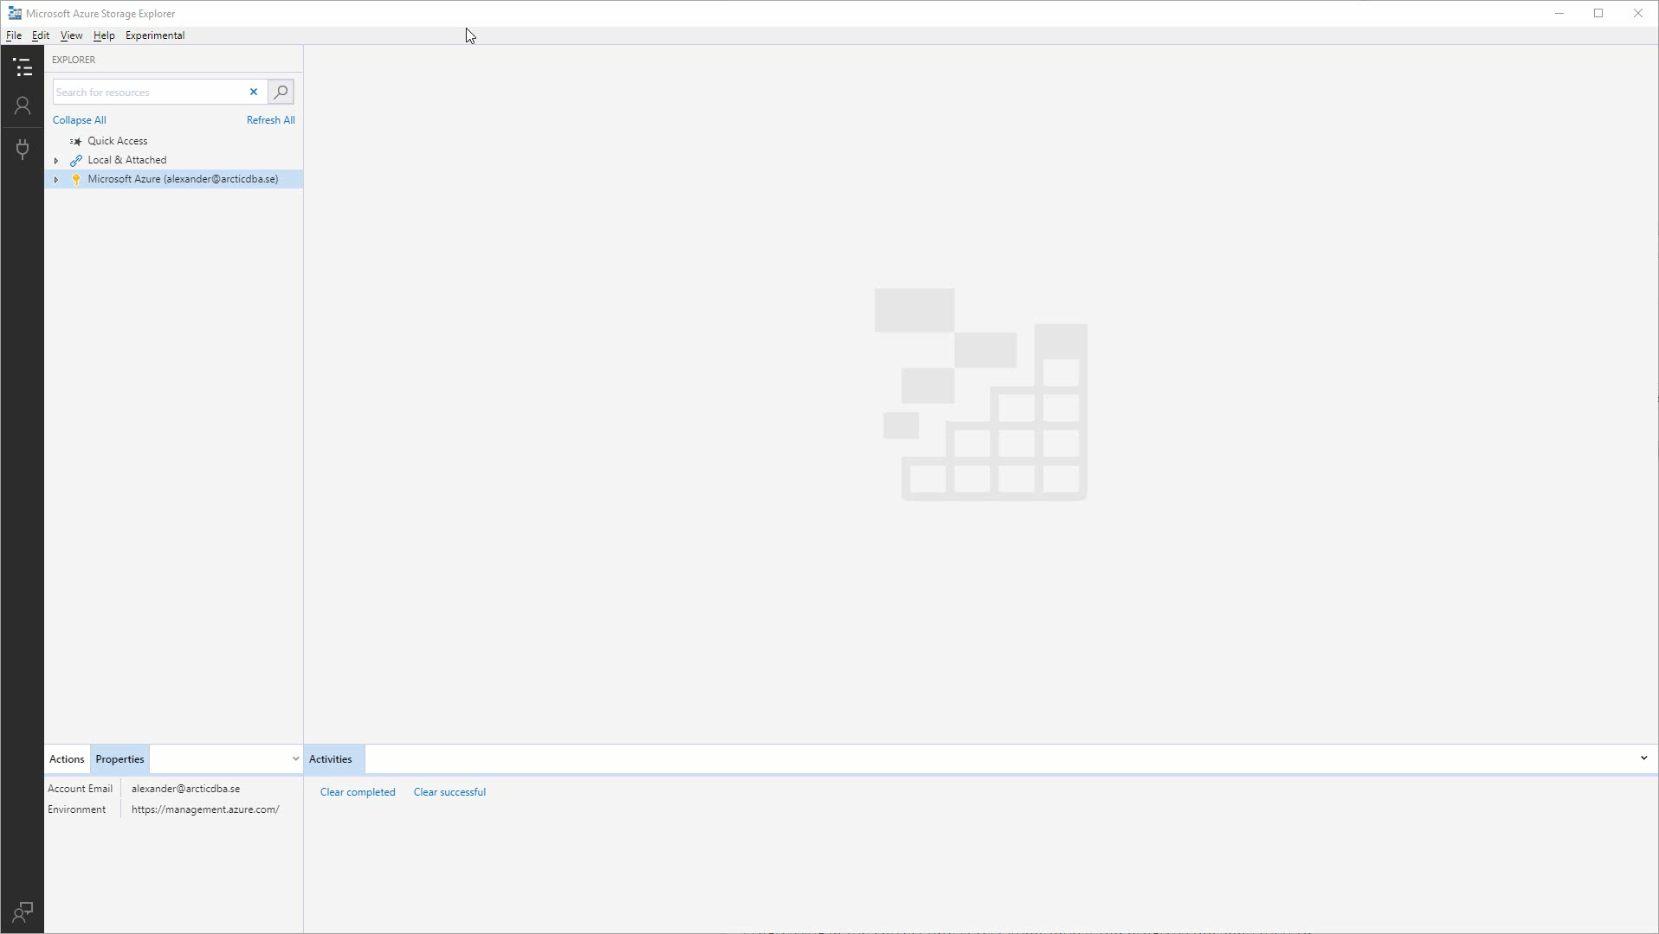

Slide 23

Exploring USE CASES for
Azure Data Lake

Slide 27
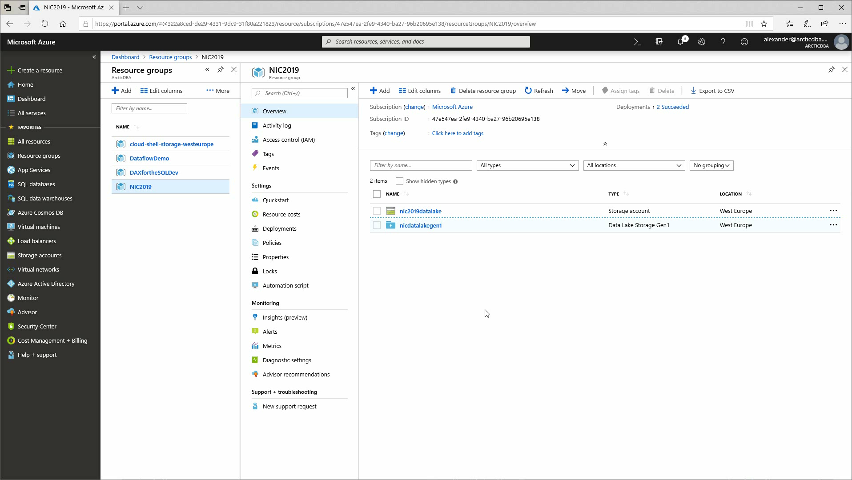

Slide 28

AVOIDING common
Azure Data Lake mistakes

Slide 29
Architecting on the FLY

Slide 30
PLAN THE LAKE
more planning, less data swamp

Slide 31
ZONING without thought

Slide 32
PLAN THE ZONES
more zoning, less data getting lost

Slide 33
Ignoring SECURITY

Slide 34
THINK ABOUT SECURITY
let the right ones in

Slide 35
Ignoring USER ADOPTION

Slide 36
USEFUL, RELEVANT, EASY
the right tools for the job

Slide 37
Ignoring data QUALITY

Slide 38
MIND THE QUALITY
the right amount in the right place

Slide 39

?
?
Frågor

Slide 40
EXPLORE a data lake option
Do your HOMEWORK
Get the business ON BOARD

Slide 41


Slide 42


Slide 43




Thank you!
https://www.arcticdba.se
@arcticdba
alexander@arcticdba.se
Knee-Deep in Tech

Slide 44
Slides and demos from the conference will be available at
https://github.com/nordicinfrastructureconference/2019

Slide 45
Resources
Notes:
https://www.youtube.com/watch?v=pjHcGanZpDw
https://www.sqlchick.com/entries/2018/5/6/querying-data-in-azure-data-lake-store-with-power-bi
https://cloudacademy.com/blog/azure-data-lake-store/
https://www.blue-granite.com/blog/four-tips-for-using-azure-data-factory-to-load-your-data-to-azure-data-lake-store
https://www.blue-granite.com/blog/four-questions-to-ask-when-planning-a-power-bi-premium-deployment
https://www.jamesserra.com/archive/2018/06/azure-data-lake-store-gen2/
https://channel9.msdn.com/Shows/Azure-Friday/Azure-Data-Lake-Storage-Gen2-Overview
https://en.wikipedia.org/wiki/Azure_Data_Lake
https://azure.github.io/AzureDataLake/
https://static1.squarespace.com/static/52d1b75de4b0ed895b7e7de9/t/5be51acc4ae237695037df45/1541741281319/AzureDataLake-WhatWhyHow-MelissaCoates.pdf
https://www.talavant.com/wp-content/uploads/2018/02/Architecting-Azure-Data-Lakes.pdf
https://www.youtube.com/watch?v=B3kmG23kJ60
https://www.youtube.com/watch?v=diomoaATSqs
https://www.youtube.com/watch?v=xjKoodX_064&t=10s
https://dzone.com/articles/introduction-to-azure-data-lake
https://www.youtube.com/watch?v=b_cu_-LYe3U
http://shannonlowder.com/2017/10/azure-data-lake-step-by-step/

